Slide 1

Analysis of Covid 19 Data and Prediction of Death and Recovery of Patient
Presented By: Kabir Md. Rubayeth
M5261120
Master’s student
m5261120@u-aizu.ac.jp

Slide 2
Content
Motivation
Goal
Data set
Data Cleaning and Feature Engineering
Exploratory Data Analysis
Predicting the Recovery
Predicting the Death
Conclusion

Slide 3
Motivation
The COVID-19 pandemic has had a profound impact on the world and has resulted in many fatalities.
Accurately predicting the outcome for patients can assist healthcare providers in making informed decisions and allocate resources efficiently.
Analysis of COVID-19 data and predictions can also contribute to the development of effective treatment strategies, ultimately saving lives.
Goal
The goal of this analysis is to gain a deeper understanding of the progression of COVID-19 and the factors that influence death and recovery outcomes for patients. It can provide valuable insights that can be used by healthcare providers to improve patient outcomes and control the spread of the virus.

Slide 4
Data Set
In this Project I used Covid-19_Datase that is the same as COVID19_line_list_data.csv dataset.
This dataset taken from,
https://www.kaggle.com/sudalairajkumar/novel-corona-virus-2019-dataset
In this dataset there is 1085 rows and 20 columns.
There are three parts to my project, as follows:
Data Cleaning and Feature Engineering.
Exploratory Data Analysis.
Prediction of Death or Recovery of Patients.

Slide 5
Data Cleaning and Feature Engineering
Data Cleaning and Feature Engineering are key components of data analysis, including removing errors and inconsistencies, creating new variables, and improving predictive power. It leads to accurate results and better decision-making. Here,
First, I remove unnecessary columns.
Next, I create a data frame that shows the percentage of null values in each column of df.
Then, I select the columns that contain between 0.5% and 70% null values and replace the null values with the mean (for numerical columns) or median (for categorical columns) of each column.
Finally, the columns that contain less than 0.5% null values are remained, and I drop the rows of df that contain these null values.

Slide 6
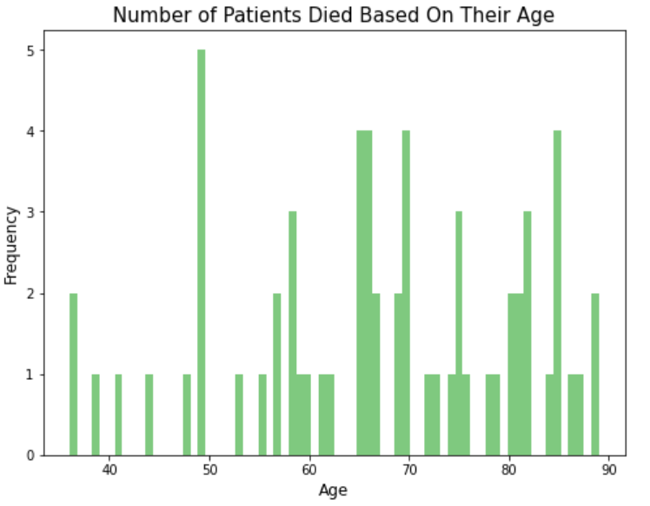
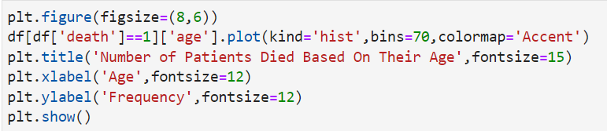
Exploratory Data Analysis
Number of patients died based on their age is given below:

Slide 7
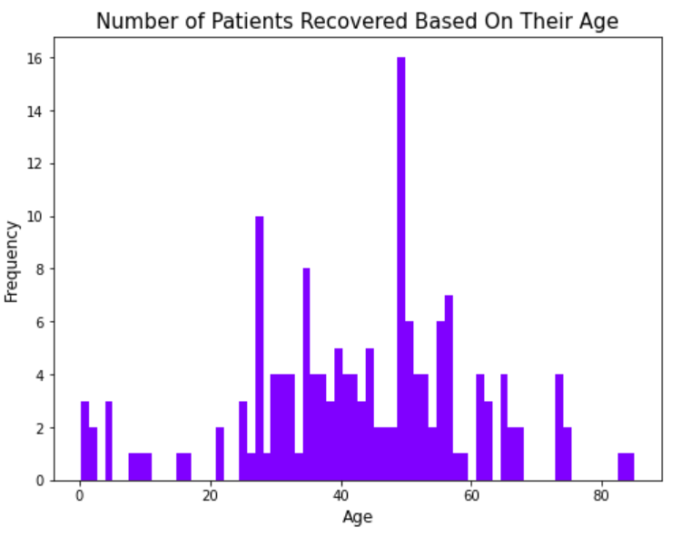
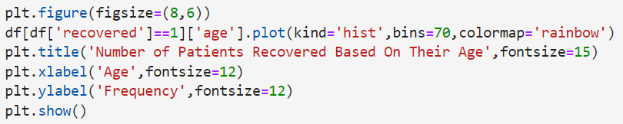
Exploratory Data Analysis
Number of patients recovered based on their age is given below:

Slide 8
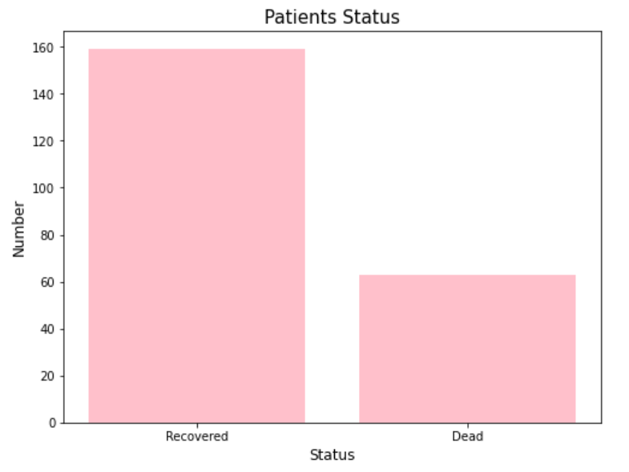
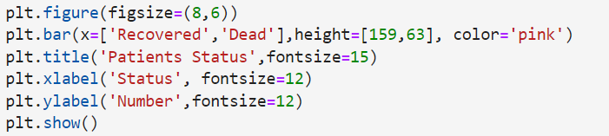
Exploratory Data Analysis
Bar chart for recovered and dead patient is given below:

Slide 9
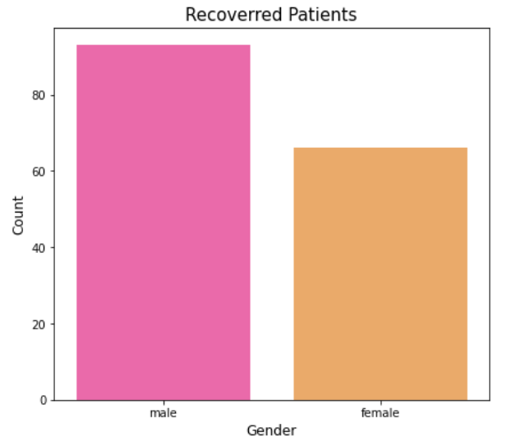
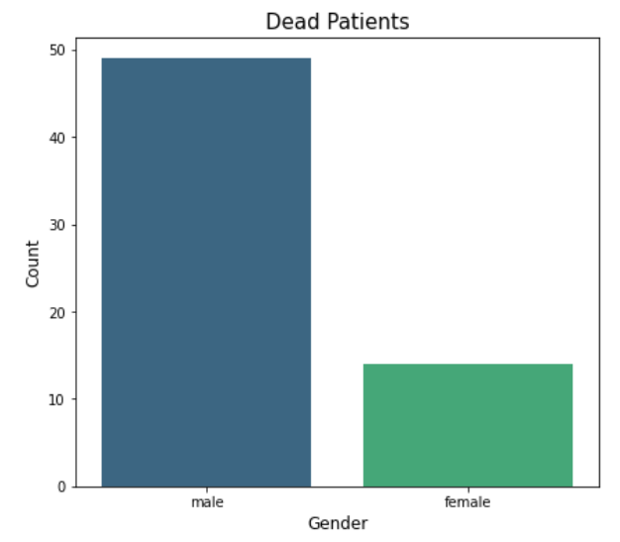
Exploratory Data Analysis
Recovered and dead patients' dependents on gender:

Slide 10
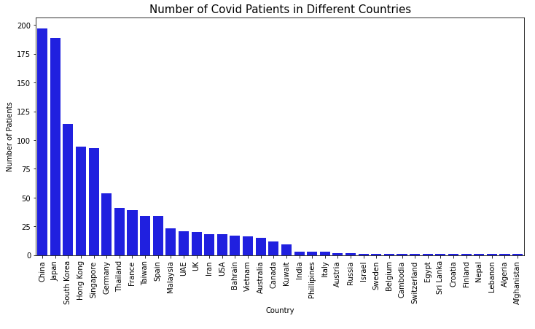
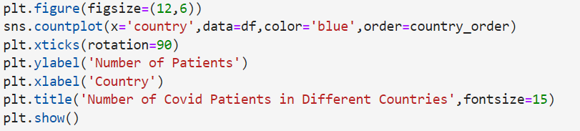
Exploratory Data Analysis
Number of covid patients in different countries:

Slide 11
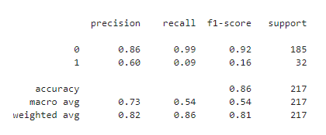
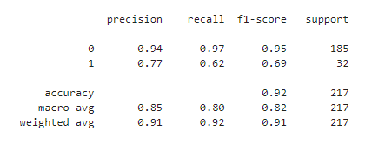
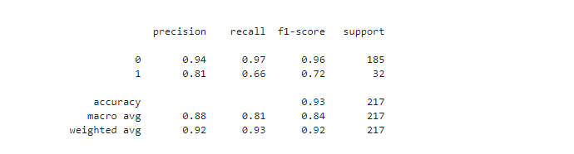
Predicting the Recovery
Logistic regression
Random Forest Classifier
XGBoost Classifier
Best option is XGBoost Classifier

Slide 12
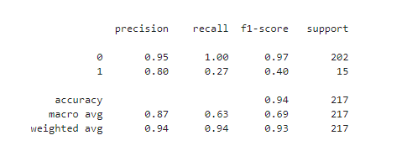
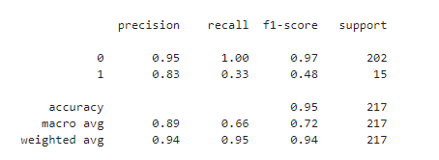
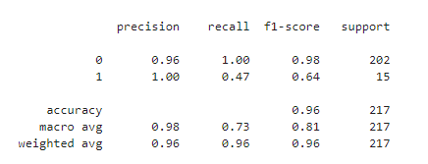
Predicting the Death
Logistic regression
XGBoost Classifier
Random Forest Classifier
Best option is Random Forest Classifier with 0.96 accuracy

Slide 13
Conclusion
I performed Data Cleaning and Feature Engineering to convert the dataset to an acceptable format.
I performed Exploratory Data Analysis and determined the factors that were more important in the death and recovery of patients.
Finally, we can say that the analysis of COVID-19 data and prediction of death and recovery outcomes for patients is crucial in understanding the progression of the disease and improving patient outcomes, as well as controlling its spread.

